Slide 1
Cardiovascular disease prediction
Troy Zhongyi Zhang

Slide 2
agenda
Study, Data, & Primary outcome
Hypothesis
Data Cleaning & Preprocessing: Predictors
Table 1
Exploratory Data Analysis: Visualization
Unsupervised Learning
Supervised Learning
Ensemble Learning
Extended Thinking

Slide 3
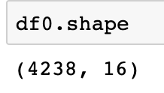
Study, data, & primary outcome
World Health Organization estimated 12 million deaths worldwide per year due to Heart diseases.
Half of the deaths in the US and other developed countries are due to Cardiovascular Diseases.
The early prognosis of cardiovascular diseases can aid in making decisions on lifestyle changes in high risk patients and in turn reduce the complications. This research intends to pinpoint the most relevant/risk factors of heart disease as well as predict the overall risk using Machine Learning models.
Source The dataset is publicly available on the Kaggle website, and it is from an ongoing cardiovascular study on residents of the town of Framingham, Massachusetts. The classification goal is to predict whether the patient has 10-year risk of future coronary heart disease (CHD)
The dataset provides the patients’ information. It includes over 4,000 records and 15 attributes. Variables Each attribute is a potential risk factor. There are both demographic, behavioral and medical risk factors.
TenYearCHD: 10-year coronary heart disease prediction – 0/1

Slide 4
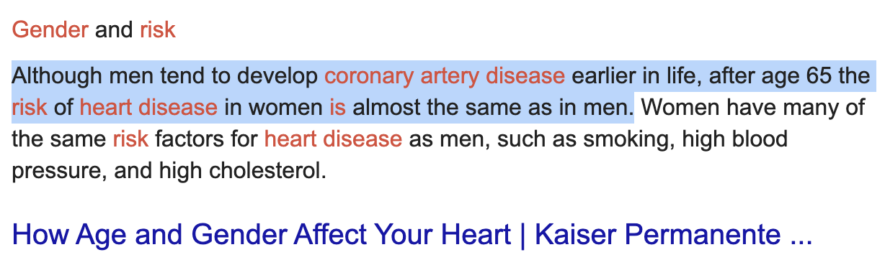
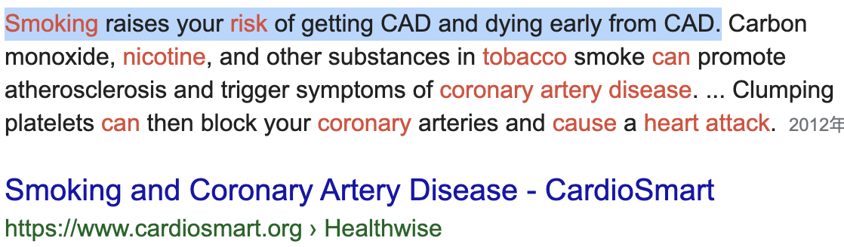
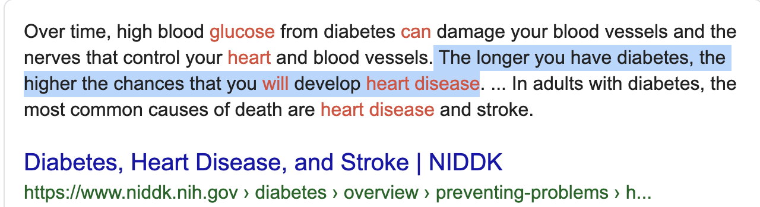
Hypothesis
TenYearCHD is highly correlated with diabetes, glucose, and smoking.
Education, age, and gender will not affect much to the TenYearCHD and the glucose level.
Most of my prediction will be 0s, which means not risky for coronary disease in the next 10 years, because the glucose level for people is very low(mostly 55 - 100).
(Normal blood sugar levels are less than 100 mg/dL after not eating for at least 8 hours; <140 mg/dL two hours after eating)
Machine learning: Ensemble ML will give better prediction accuracy than Base ML models. – Accuracy comparison

Slide 5
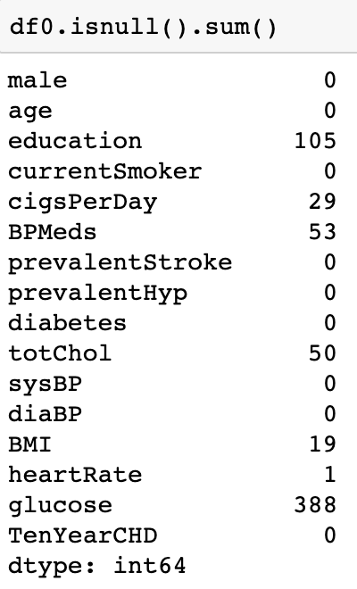
Cleaning & preprocessing
Introduction:
Systolic pressure; Diastolic blood pressure
Prevalent Stroke: whether or not the patient had previously had a stroke (Nominal)
Prevalent Hyp: whether or not the patient was hypertensive
Missing Values Imputation:
Mean and medium to fill the null values in the cigsPerDay, BPMeds, totChol, BMI, and heartRate column.
KNN for education after scaling
Glucose: (compared RMSE without using the Education, training set = 92.5%)
Multiple Regression: 15.1074
Gradient Boosting Regressor: 17.7771
XGBoost Regressor: 18.3610
Error: 15/100-150 =15/150 -> 15/100 = 10%-15%.
number of predictors

Slide 6
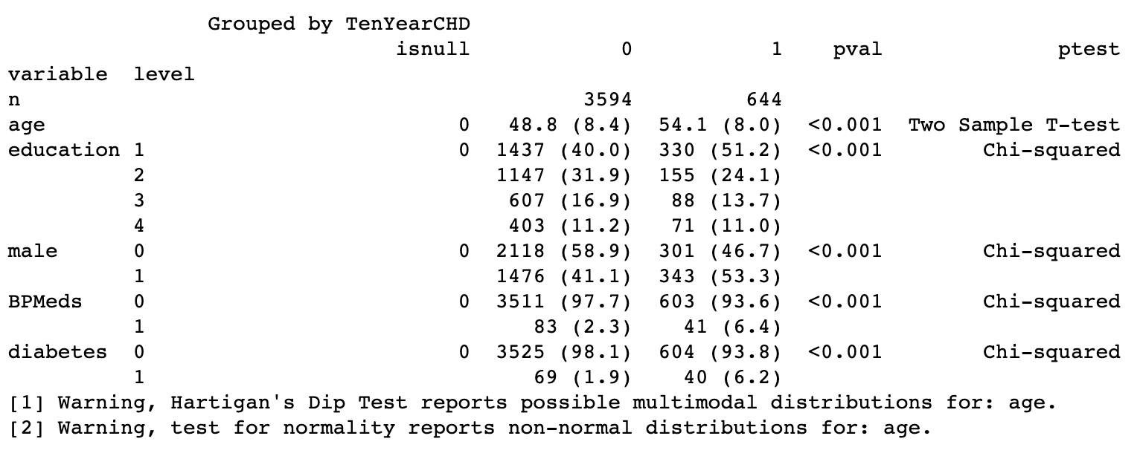
Table 1
Outcome – TenYearCHD
Age
Education: 1, 2, 3, 4
Male: 0, 1
Blood Pressure Meds: 0, 1
Diabetes: 0, 1
H₀: μ₁=μ_{2;} no significance relationship
H_{a}: some relationships
P<0.05 -> Rejecting null hypothesis; there are relationships!

Slide 7
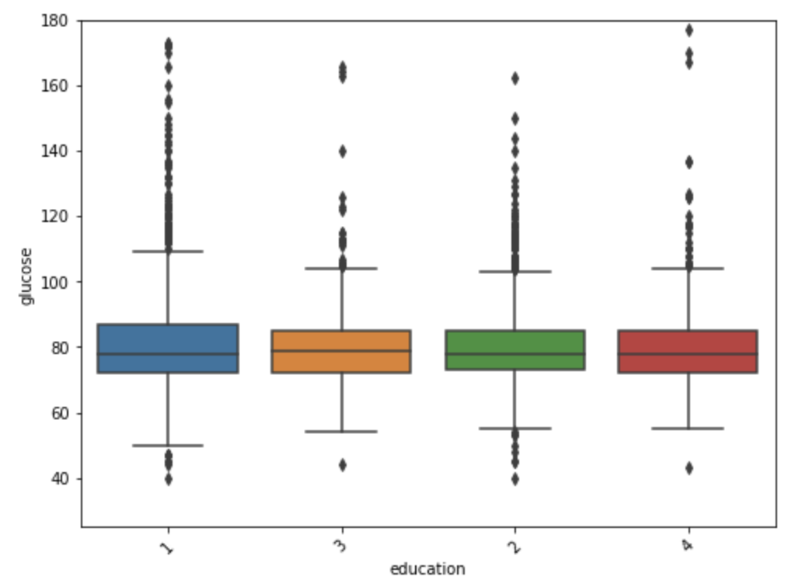
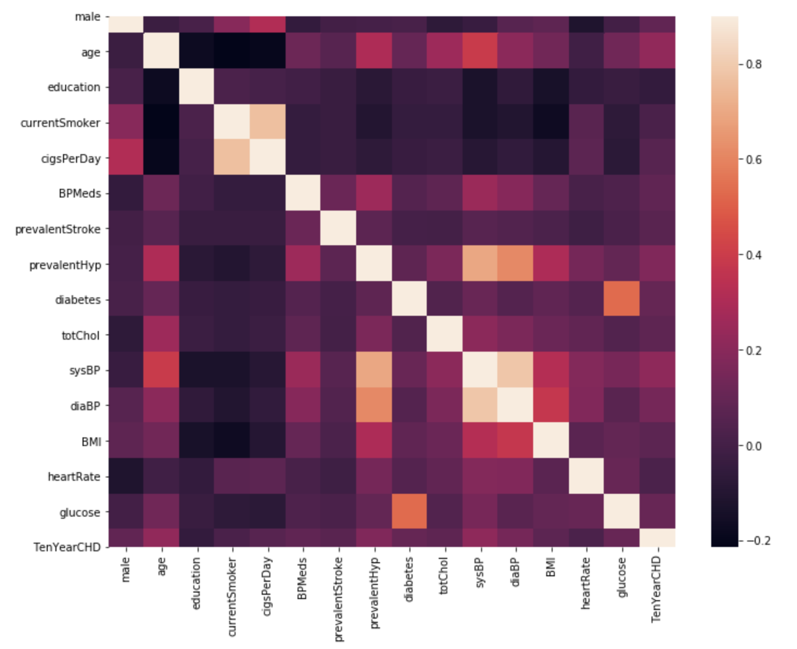
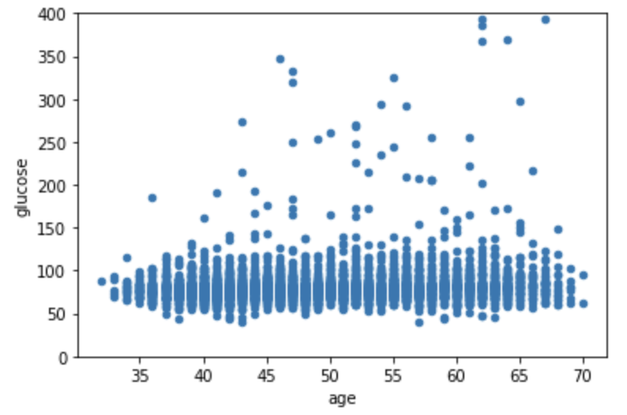
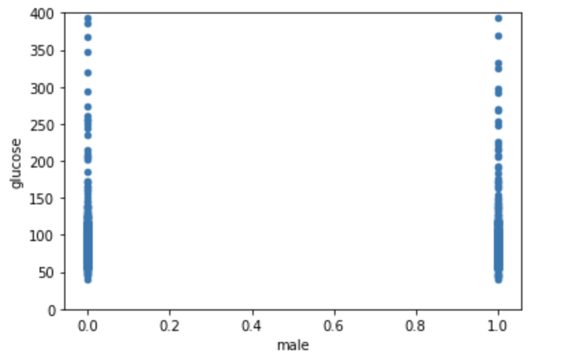
Exploratory data analysis
Back to my hypothesis
Age and education could indirectly affect TenYearCHD through affecting glucose.
Highly correlated with outcome:
Age
prevalentHyp
prevalentStroke
Diabetes
totChol
sysBP
diaBP

Slide 8
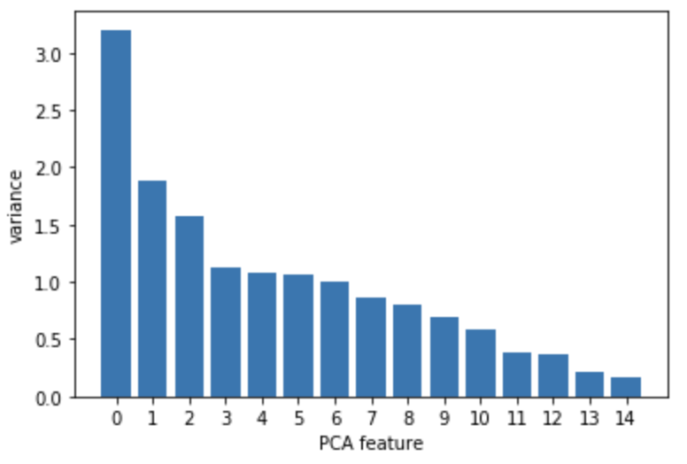
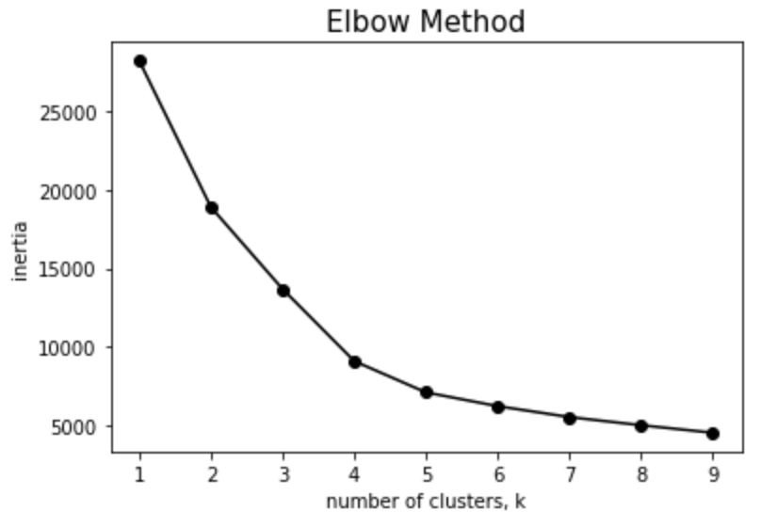
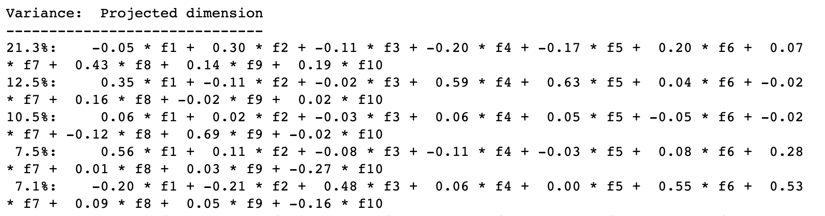
Unsupervised
Scaling dataset
PCA
15 PCs in total
PC1: 21.3%
PC2: 12.5%
PC3: 10.5%
Total: 44.3%
Clusters to detect any anomalies or outliers

Slide 9
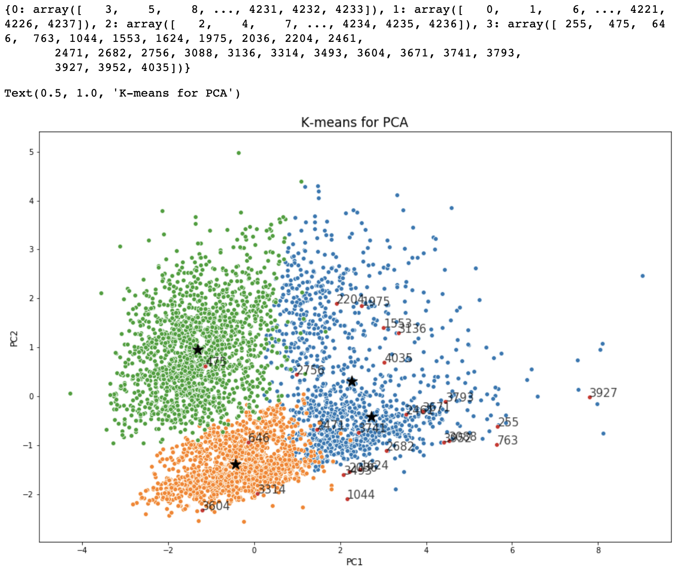
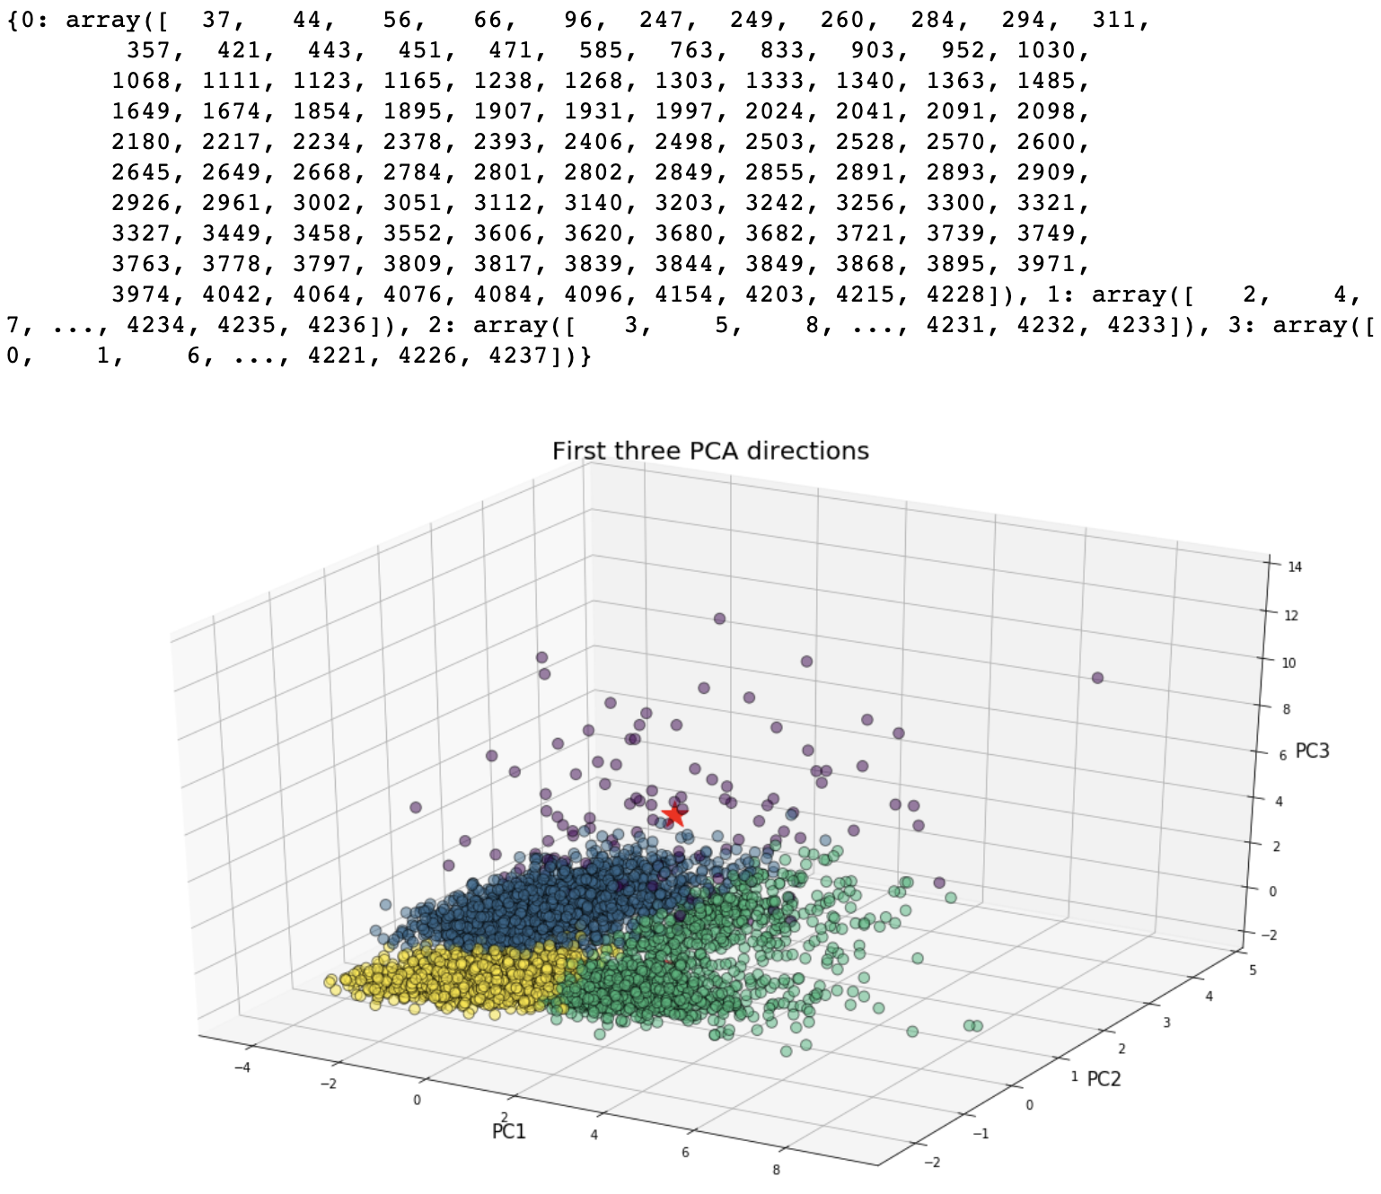
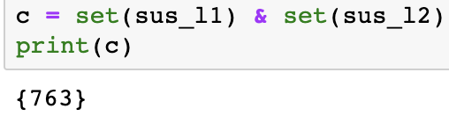
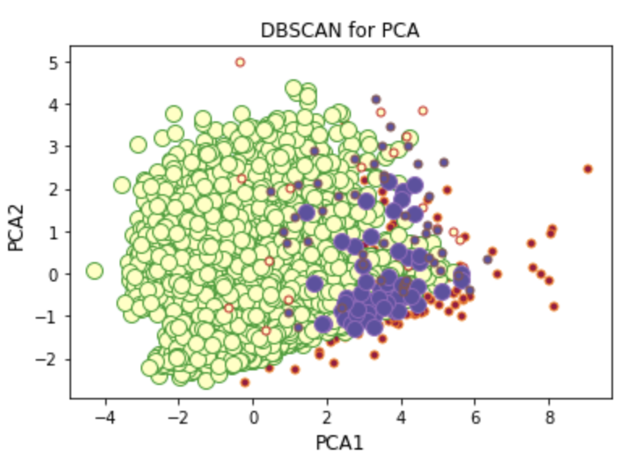
The common outlier data is the patient at index number 763
Very high glucose
totChol | sysBP | diaBP | BMI | heartRate | glucose
107–696 | 83.5–295 | 48–142.5 | 15.54–56.8 | 44–143 | 40–394
Normal data! Keep it.
Notes:
Core points, border points, anomalies

Slide 10
Supervised learning models
Training set = 80%; CV = 5
 | Model Name | Accuracy on Testing | Accuracy on Training | AUC_ROC | DeLong 95% CI | 1,000 Boostrapping 95% CI | Fitting condition
1 | Logistic Regression | 0.8656 | 0.8484 | 0.6629 | (0.6074, 0.7184) | (0.6148, 0.7075) | Good
2 | Decision Tree Classifier | 0.7807 | 0.8484 | 0.5405 | (0.4957, 0.5852) | (0.5016, 0.5790) | Overfitting
3 | Random Forest Classifier | 0.8620 | 0.9035 | 0.7125 | (0.6599, 0.7651) | (0.6667, 0.7566) | A little overfitting
4 | KNN with scaling | 0.8514 | 0.8546 | 0.5952 | (0.5387, 0.6518) | (0.5482, 0.6422) | Good
5 | SVM with scaling | 0.8585 | 0.8602 | 0.6050 | (0.5426, 0.6674) | (0.5508, 0.6572) | Good
6 | AdaBoost | 0.8632 | 0.8584 | 0.7042 | (0.6514, 0.7570) | (0.6594, 0.7474) | Good
7 | GradientBoosting | 0.8644 | 0.8584 | 0.7127 | (0.6607, 0.7647) | (0.6689, 0.7554) | Good
8 | XGBoost | 0.8691 | 0.8563 | 0.7155 | (0.6644, 0.7667) | (0.6732, 0.7561) | Good
9 | ANN with SMOTE and scaling | 0.7783 | 0.9834 | 0.5232 | (0.4622, 0.5842) | (0.4737, 0.5754) | Overfitting
10 | Bagging Classifier | 0.8644 | 0.8440 | 0.5893 | (0.5323, 0.6463) | (0.5410, 0.6354) | Good

Slide 11
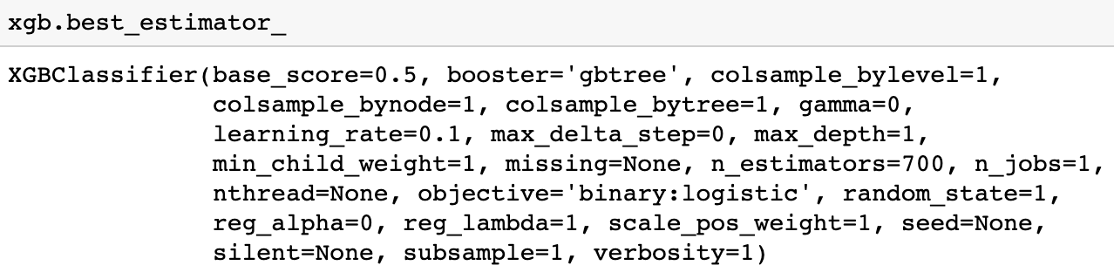
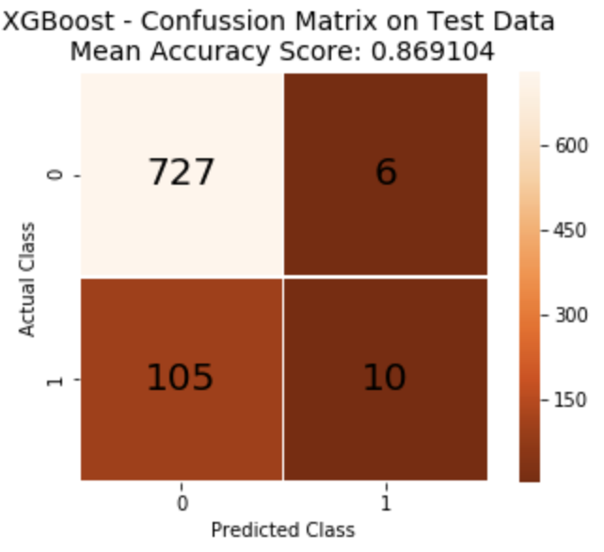
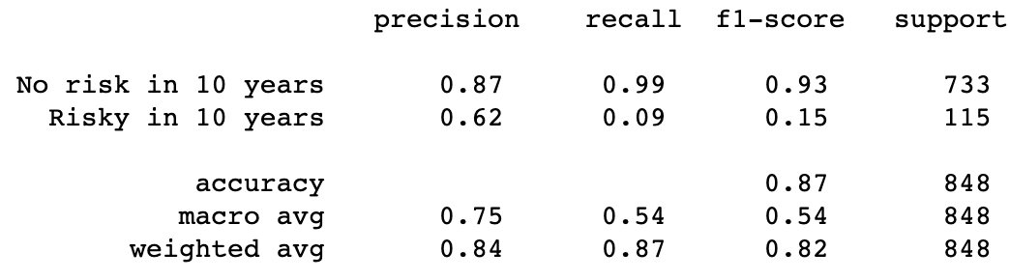
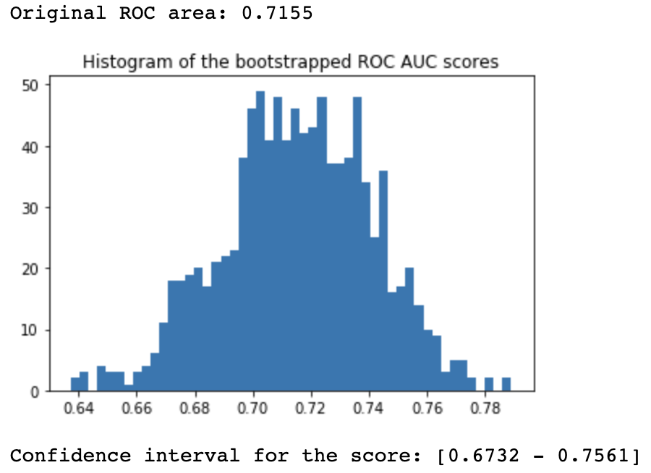
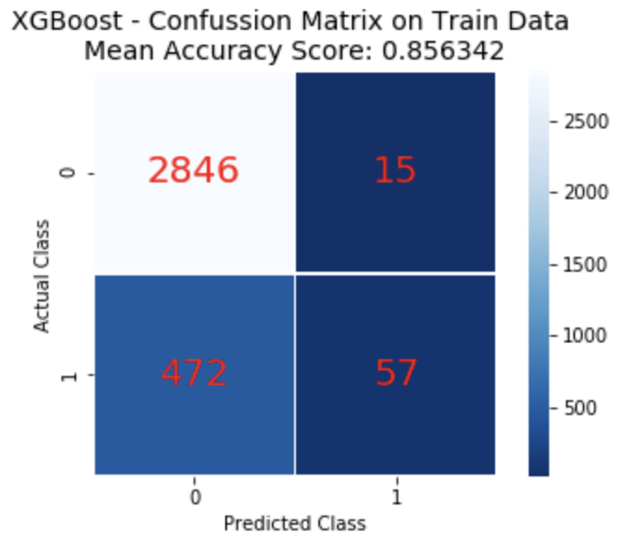
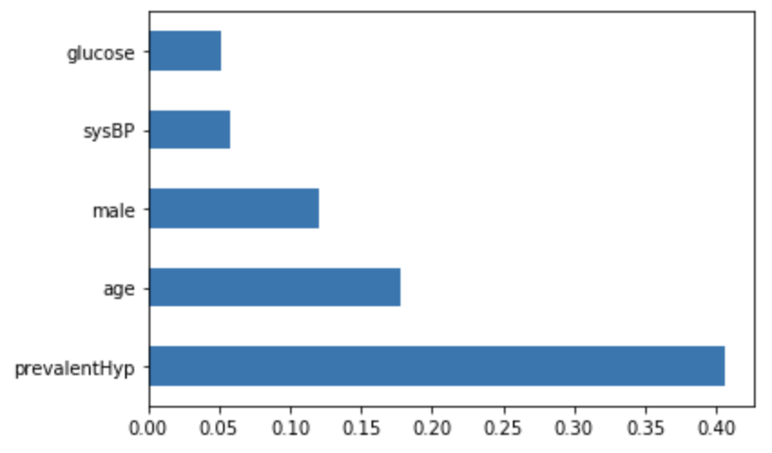
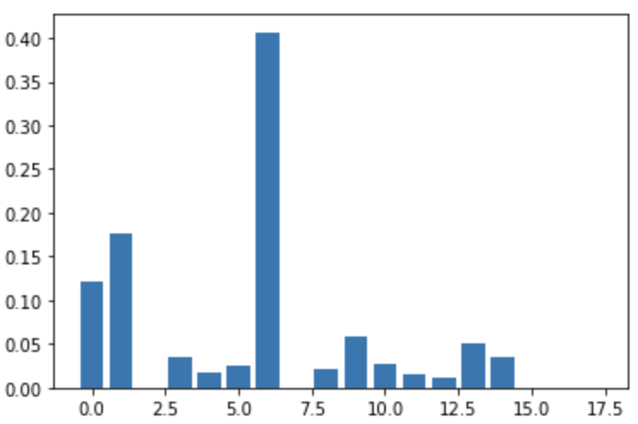
XGBoost
Sensitivity = TP/(TP+FN) = 10/(10+105) = 8.70%
Specificity = TN/(TN+FP) = 727/(727+6) = 99.18%
Sens: Ratio of ppl predicted to have CHD over ppl truly CHD
Spec: Ratio of ppl predicted not to have CHD over ppl truly no CHD
Notes:
Precision = TP/(TP+FP) what percentage of patient are really 1 out of all predicted to be 1.
Recall = TN/(TN+FN) what percentage of patient are really 0 out of all predicted to be 0.
F1 = 2(precision * recall)/(precision + recall)
Support = sum of patient in each category, number of occurrence in each category.
XGBoost is advanced version of gradient boosting, focused on efficiency and speed. GradientBoosting is very slow
Both xgboost and gbm follows the principle of gradient boosting. There are however, the difference in modeling details. Specifically, xgboost used a more regularized model formalization to control over-fitting, which gives it better performance. XGBoost uses 2nd order derivatives where GBM uses the loss function. XGBoost – Regularized boosting Dropout regularization for trees; GB focused on the variance but not the trade-off between bias, XGBoost focus on the regularization factors

Slide 12
Extended Thinking
Feature Engineering
My dataset is a mixture of continuous and discrete. I couldn’t apply Naïve Bayes Model directly on my dataset. GaussianNB – continuous; MultinomialNB – discrete. 2 ways to do:
I can transfer all the continuous variables into categorical variable, such as “Very Low – 0, Low – 1, Medium – 2, High – 3, Very High - 4” (20% each, (max – min)/5). Remove the previous continuous columns, and then I can fit a MultinomialNB.
I can break my dataset into 2 parts: 1 with only categorical, and 1 with only continuous. GaussianNB – continuous; MultinomialNB – discrete. Then transform all the dataset by taking the class assignment probabilities (with predict_proba method) as new features: np.hstack((multinomial_probas, gaussian_probas)).
Finally, refit a new model (e.g. a new gaussian NB) on the new features.
Found a package called “mixed_naive_bayes”.
Stacking & Soft/Hard voting classifiers
Transform my dataset into a spectrum to apply CNN according to the color distribution to predict the 10-year coronary heart disease.
Notes:
Stacking is great for small or medium size datasets
Usually, XGBoost could be better than stacking
Stacking is less widely used as bagging and boosting:
1. Split the training set into two disjoint sets.
2. Train several base learners on the first part.
3. Test the base learners on the second part.
4. Using the predictions from 3) as the inputs, and the correct responses as the outputs, train a higher level learner.

Slide 13
questions

Slide 14
Thank you!

